Slide 1
PARASITOLOGY (BIOL 460)
UNIT 8 C
PARASITIC ARACHNIDS

Slide 2
PARASITIC ARACHNIDS
The Class Arachnida of the Phylum Arthropoda, contains Spiders, Scorpions, Ticks and Mite,s and King Crabs
(the only aquatic members, and which some authorities separate into a class of its own, Merostomata.
One major characteristic (distinguishing) is the two-part division of the body into a prosoma and opisthosoma, and the absence of antennae.

Slide 3
PARASITIC ARACHNIDS CONT’D
Members of the Class that are of immense importance to humans and livestock animals are in the Subclass Acari and Super Order Acarina.
Ticks and Mites are basically similar however, they have some distinct differences as follows:

Slide 4
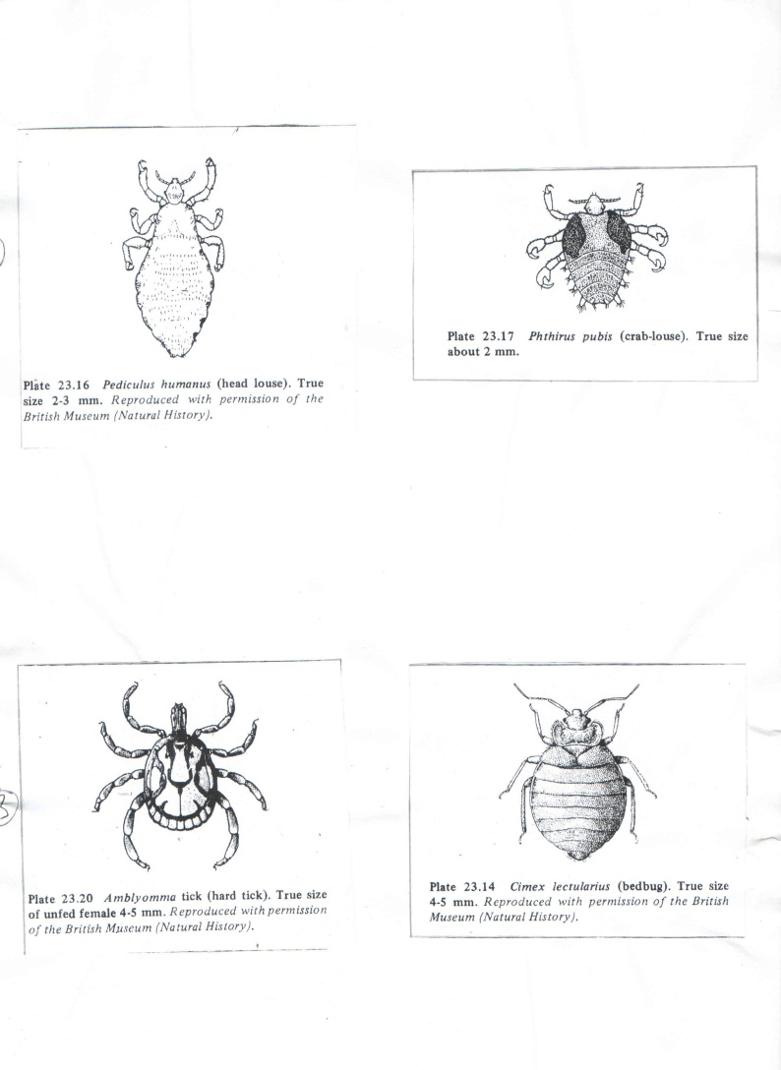

Slide 5
PARASITIC ARACHNIDS CONT’D
Ticks
Hypostome is toothed and exposed
Large, macroscopic
Haller’s organ present on first tarsi
Peritreme absent
Ticks feed on blood and lymph
Mites
Hypostome is unarmed and hidden
Small, usually microscopic
Haller’s organ is absent
Peritreme present in Mesostigmata
Most mites feed on lymph or other secretions rather than on blood

Slide 6
TICKS
Ticks are important as agents and vectors of disease causing pathogens because of the following pathogenic conditions attributable to them:
1. Anemia- blood loss in heavy infections can be considerable
2. Dermatosis- inflammation, swelling, ulcerations and itching can result from a tick bite;

Slide 7
TICKS CONT’D
these reactions are often caused by pieces of mouthparts left in a bite wound (after a tick is forcibly removed), constituents of tick saliva
and, secondary, bacterial infection may also be involved.
3. Paralysis- a condition known as tick paralysis is common in humans, dogs, cattle, and other mammals when they are bitten near the base of their skull, this condition seems to result from toxic secretions of the tick and is quickly reversed when the tick is removed.

Slide 8
TICKS CONT’D
4. Otoacariasis-an infestation of the ear canal by ticks causing a serious irritation, sometimes accompanied by severe infection.
5. Infections- besides transmitting common pyogenic (pus-producing ) infections, ticks also transmit viruses, bacteria, rickettsias, spirochetes, protozoa and filariae.
Losses to the livestock industry in the US and Australia notably due to tick infestations and control efforts run into billions of dollars

Slide 9
Biology of Ticks (Some Highlights only)
All ticks undergo four basic stages in their life cycles, namely, egg - larva – nymph – adult, all of which might take 6 weeks to 3 years to complete depending on certain factors..
Ixodids have only one nymphal instar but argasids have five;
copulation occurs on the host; a blood meal is usually required for egg production, but with some exceptions, and some are parthenogenetic

Slide 10
Biology of Ticks (Some Highlights only) cont’d
An engorged female drops to the ground from the host, and deposits eggs in the soil or humus.
A six-legged larva hatches from each of the 100 to 18,000 eggs and climbs onto a low vegetation to await a host, on which it feeds and moults to an eight-legged nymph

Slide 11
Biology of Ticks (Some Highlights only) cont’d
Moulting through all instars may occur on one, two, three or many hosts giving rise to one-host, two-host, three-host ticks, etc.
Most Ixodids are three-host ticks whereas argasids, with their multiple nymphal stages are many-host ticks; some ticks are however, host-specific whilst most are opportunists that will feed on a variety of hosts.

Slide 12
Biology of Ticks (Some Highlights only) cont’d
Ticks are hardy and can withstand periods of starvation as long as 16 years; some have a life-span of up to 21 years.
Two families of ticks are of medical importance, viz
Argasidae –soft ticks and
Ixodidae – hard ticks

Slide 13
Family Argasidae (Soft Ticks)
This contains five genera of which the genus, Ornithodoras is of great importance because the species O. moubata sucks the blood of humans
and can transmit the borrreline of Relapsing fever.
Once infected with Borrelia duttoni, a tick remains infected for life, and would transmit the borreline to new generations of ticks

Slide 14
Family Argasidae (Soft Ticks) cont’d
Human infection occurs when the borreline are deposited on the skin in fluid from the coxal gland when the tick bites or, when the tick is crushed on the skin
They are ectoparasitic and can survive for long periods without a host; they survive best in dry climates
Life cycle takes 6-12 months and there are up to eight nymphal stages, all spent on one host; both sexes feed on blood

Slide 15
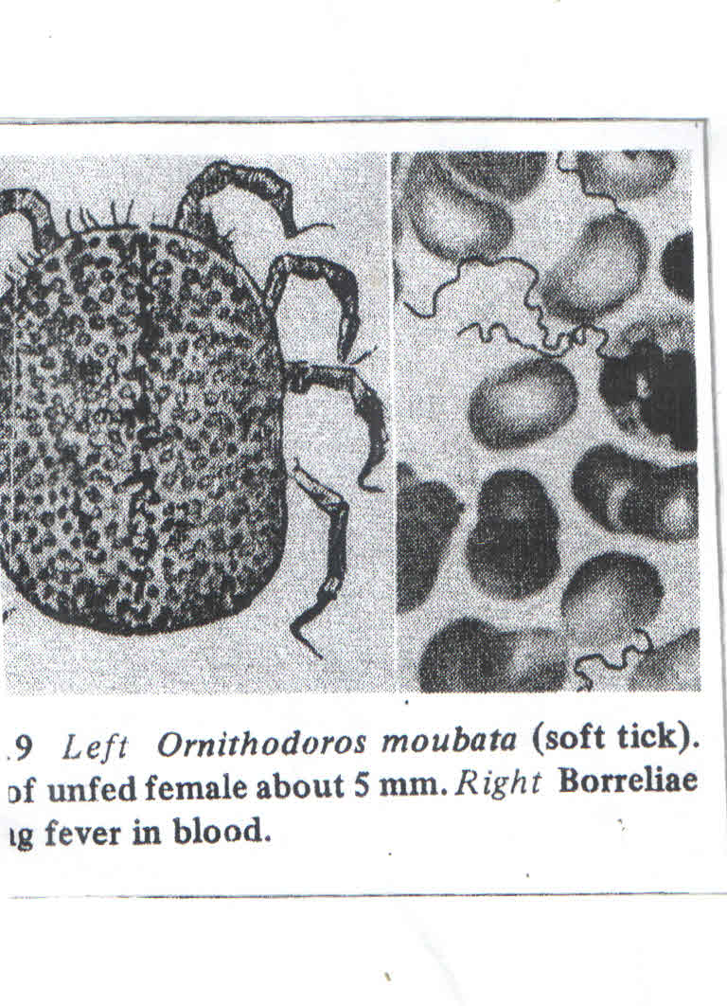

Slide 16
Family Argasidae (Soft Ticks) cont’d
Generally, argasid ticks inhabit localities of extremely low relative humidity; those that occur in wet climate seek dry microhabitats in which to live.
Unlike ixodid ticks, argasid ticks feed repeatedly, resting away from a host between meals,
and hiding in loose soil, crevices, bird’s nests, etc.

Slide 17
Family Argasidae (Soft Ticks) cont’d
Adult females lay eggs in their hiding places several times between feedings; the total number of eggs laid is low, usually less than 500.
The species in the genus Ornithodoros are closely related and form a complex and all of them are important vectors of relapsing fever

Slide 18
Family Argasidae (Soft Ticks) cont’d
Ornithodoros ticks are thick, leathery and rounded, are over 100 species;
all parasitize mammals including bats but usually not birds or reptiles, although one species is reportedly been found on marine birds in N. America.

Slide 19
Family Ixodidae (Hard Ticks)
These are easily recognized by the terminal position of their capitulum (gnathosoma or the anterior region of the body which bears the mouthparts) which can be seen in dorsal view,
In contrast to that of soft ticks (Argasidae) which is subterminal and cannot be seen in dorsal view.
They have a hard dorsal covering and mouthparts which can be seen from above.
They may be dark or brightly coloured with metallic markings.

Slide 20
Family Ixodidae (Hard Ticks) cont’d
There are three subfamilies: Ixodinae with a single genus, Ixodes; Amblyominae, containing the genus Amblyomma, Dermacentor
and two others; and Rhipicephalinae containing five genera.
Among the hard ticks, the genera Ixodes, Dermacentor and Amblyomma are medically important:

Slide 21
Family Ixodidae (Hard Ticks) cont’d
Both Amblyomma and Dermacentor transmit tick-borne typhus
Dermacentor ticks transmit tick-borne encephalitis.
Ixodes ticks are vectors of Lyme disease caused by the spirochaete Borrelia burgdorteri

Slide 22
Family Ixodidae (Hard Ticks) cont’d
Hard ticks parasitize humans and animals, with both sexes feeding on blood
Eggs are laid in a single batch after which the female dies
There is only one larval and one nymphal stage from which the adult emerges;
each stage of development may be spent on a different host; a blood meal is required for each stage.

Slide 23
Ixodes sp.
The largest genus of hard ticks, with over200 species, most of which parsitize small mammals, they being small themselves
Lyme disease which Ixodes transmit is named after the town, old Lyme in Connecticut, USA, where an epidemic of arthritis occurred in the mid-1970s:

Slide 24
Ixodes sp. cont’d
Many of those afflicted noticed a skin erythema (red swelling and rash) at the site of a tick bite prior to the onset of joint pains
The rash sometimes spread,and was often accompanied by fever and headaches
It is now known that neurological symptoms, facial, paralysis, meningitis, and occasionally cardiac disease occur in some cases.

Slide 25
Ixodes sp. cont’d
Half of all arthropod-transmitted infections in the US are with Borrelia burgdorferi, making it the country’s leading arthropod-borne disease.
Lyme disease is a classic zoonosis (because of unselective feeding habits of the tick, especially nymphal stages.

Slide 26
Ixodes sp. cont’d
and participation of rodent and deer reservoirs, as well as cats, raccoons, opossums, chickens, lizards, all serving as hosts) in which landscape characteristics and human activities all play major roles in transmission.

Slide 27
Amblyomma sp.
The about 100 species in this genus are restricted to the tropics though A. americanum occurs in temperate N. America and Canada
Larvae and nymphs are common in birds although adults usually feed only on large animals; all three stages, however, readily bite humans which is unusual among hard ticks.

Slide 28
Dermacentor sp.
The genus contains about 30 species which are among the most medically important of all ticks.
Larvae feed on small mammals whilst the adults feed on small mammals but prefer larger gosts such as deer,sheep, cattle, coyotes and humans
Life cycles range up to a year when hosts are available, or up to three years when hosts are plentiful; all stages can survive about a year without feeding

Slide 29
Dermacentor sp. cont’d
D. andersoni is a vector for several diseases of humans, including tick paralysis, powassan encephalitis virus, tularaemia, etc. etc.
Other species of Dermacentor are vectors ofseveral diseases caused by viruses and rickettsias.

Slide 30
Immunity to Ticks
Mammals can develop resistance to hard ticks; some strains of host species are naturally more resistant than others.
Acquired resistance, often, is manifested as failure of the parasite, especially, larvae and nymphs to engorge fully.
Antigens responsible for these immune reactions are of bothsalivarygland and gut origin.

Slide 31
MITES
Mites also belong to the suborder Acarina of the class Arachnida, and Order Prostigmata.
The genus Trombicula of the Family Trombiculidae is of medical importance; the Family contains Chjigger mites which are common in tropical and temperate countries.
Members of the Family are unique among mites that attack humans in that only the larval stage is parasitic; nymphs and adults are predators.

Slide 32
MITES CONT’D
Over 1200 species have beendescribed from larvae only.
Adult chiggers are among the largest of mites, about 1.0mm or more in length.
There are two medical aspects of chigger bite: chigger dermatitis and transmission of pathogens

Slide 33
MITES CONT’D
Larval chiggers do not burrow into skin as is commonly thought:
As their mouthparts penetrate the epidermis, the mites inject salivary secretions that are proteolytic, killing
and digesting host cells, which the parasite then sucks up along with interstitial fluids
Simultaneously, host cells harden under the influence of other salivary secretions to forma tube, the stylostome

Slide 34
MITES CONT’D
The mite retains its mouthparts in the stylostome , using it like a drinking straw, until engorged and then drops off.
Not all chiggers cause itching reaction: those that do usually have detached before a host reaction begins;
some people are immune to their bites whereas others may incur a violent reaction.

Slide 35
MITES CONT’D
Other trombiculid species, some representing other genera, bite humans or are vectors of a rickettsial disease in humans, called SCRUB TYPHUS (Tsutsugamushi disease).
The microorganism, Rickettsia tsutsugamushi, is transovarially transmitted among mites;
wild rodents, particularly species of Rattus are reservoirs.

Slide 36
Trombicula sp. (Order Prostigmata; Family Trombiculidae)
Trombiculid mites transmit scrub typhus, especially in S. East Asia.
The rickettsial organism which cause the disease can be passed through several generations of mites .
The bite of an infected mite larva can also cause severe allergic dermatitis known as scrub itch.

Slide 37
Trombicula sp. (Order Prostigmata; Family Trombiculidae) cont’d
Nymph and adult mites are not parasitic; they live in the soil in areas of selected scrub vegetation;
the larvae are ectoparasitic on humans and warm-blooded animals, sucking lymph and tissue fluids from their hosts.

Slide 38
Trombicula sp. (Order Prostigmata; Family Trombiculidae) cont’d
The larvae can often be found around the waist under a belt on the abdomen, or under a wrist or shoe strap.
The larvae drop off after several weeks and continue their development in the soil.

Slide 39
Family Sarcoptidae (Order Oribatida)
Sarcoptid mites are skin parasites of mammals: they cause SCABIES or SARCOPTIC MANGE.
The mites mate on the skin of their host, males inseminating immature females;
eggs hatch in 3-8 days and larvae and nymphs emerge and wander on the skin surface A species is Sarcoptes scabiei (the itch mite)

Slide 40
Family Sarcoptidae (Order Oribatida) cont’d
The female cuts the horny layer of the skin, and forms tortuous tunnels;
the tunnelling and the secretory and excretory products produce intense itching sensation in most infected persons
The skin between the fingers , breasts and shoulder blades and around the penis and in creases of the knees and elbows is most often infected.

Slide 41
Family Sarcoptidae (Order Oribatida) cont’d
Scratching may cause bleeding and secondary infection.
The entire life cycle is, thus, completed under the skin.
Sracoptid mange in domestic and wild mammals is essentially the same as in humans.
Hairless or short-haired regions of the body are most affected.

Slide 42
Family Sarcoptidae (Order Oribatida) cont’d
A cycle of resurgence of scabies infection occurs in the world every 17- 20 years for reasons not clear but presumably due to changing immunity in the human population.
Infection is readily passed on to humans who are in contact with mangy animals.

Slide 43
Family Sarcoptidae (Order Oribatida) cont’d
Ticks and mites are of immense medical and veterinary importance in that many cause diseases themselves and many are vectors of serious pathogens.
All ticks are epidermal parasites during their larval, nymphal and adult instars whereas many mites are parsites on or in the skin, respiratory system or other organs of their hosts.

Slide 44
Family Sarcoptidae (Order Oribatida) cont’d
Some mites though not parasites of vertebrates, stimulate allergic reactions when they or their remains come into contact with a susceptible individual.
Ticks are present in every country of the world, but mites are even more ubiquitous as they thrive on land, in freshwater and in the oceans.

